Slide 1


Department of BES-1
DATA STRUCTURES
24sc1203
Topic:
Merge sort
Session - 7

Slide 2



AIM OF THE SESSION
To familiarize students with the basic concept of Merge Sort concept and its time complexity
INSTRUCTIONAL OBJECTIVES
This Session is designed to:
Demonstrate: Merge Sort
Describe: Merge Sort Algorithm
List out the: Application of Merge Sort
Describe the: time complexity of merge sort
LEARNING OUTCOMES
At the end of this session, you should be able to:
Define: Merge Sort Algorithm
Describe: Time complexity of merge sort
Summarize: Merge Sort Algorithm

Slide 3
Session Outcomes
What is a Sorting Algorithm?
What is Merge Sort?
Merge Sort Approach?
Time Complexity of Merge Sort?

Slide 4
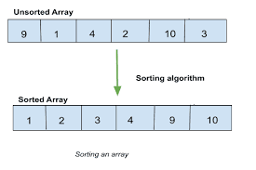
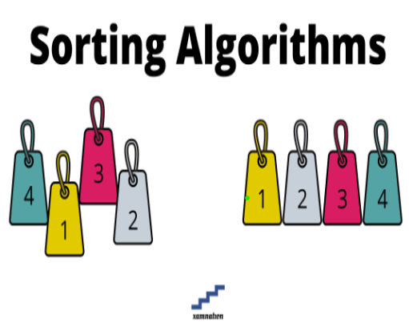
SESSION INTRODUCTION
Sorting Algorithm is used to rearrange a given array or list of elements in either ascending order or descending order according to comparison operator.
SORTING ALGORITHM :
Examples:

Slide 5
Sorting
Bubble Sort
Design Approach : Incremental
In-Place Sorting : Yes
Best Case : O(n)
Worst Case : O(n^2)
Insertion Sort
Design Approach : Incremental
In-Place Sorting : Yes
Best Case : O(n)
Worst Case : O(n^2)

Slide 6
Merge Sort Approach
To sort an array A[n1,n2.. . ….nr]:
Divide:
  Divide the n-element sequence to be sorted into two subsequences of n/2 elements each
Conquer:
  Sort the subsequences recursively using merge sort
  When the size of the sequences is 1 there is nothing more to do
Combine or Merge:
  Merge the two sorted subsequences
Merge sort is defined as a sorting algorithm that works by dividing an array into smaller subarrays, sorting each subarray, and then merging the sorted subarrays back together to form the final sorted array.

Slide 7
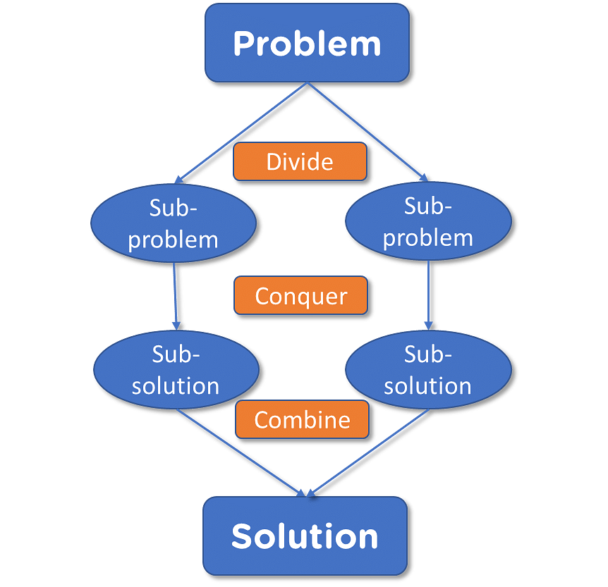
Merge sort:

Slide 8
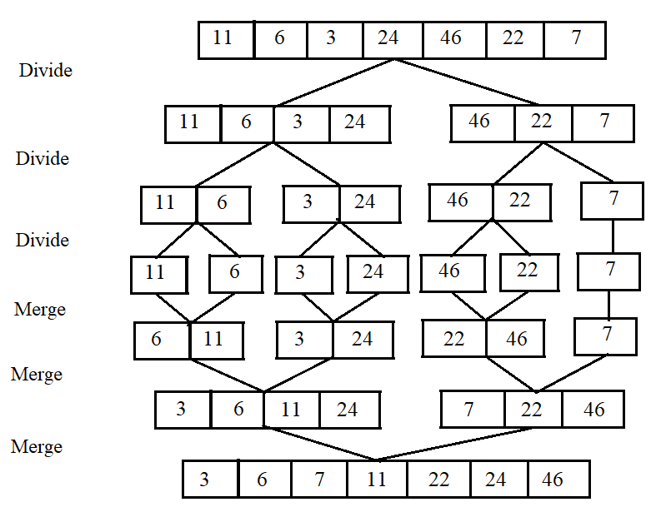
Merge sort Example:

Slide 9
EXAMPLE
1 2 3 4 5 6 7 8
11 | 6 | 3 | 46 | 24 | 22 | 7 | 10
first
mid
last
Initial Call ---- MergeSort(A,first,last)
A is an array
first ---- Starting index of an array
last ---- End index of an array
mid ---- (first + last)/2

Slide 10
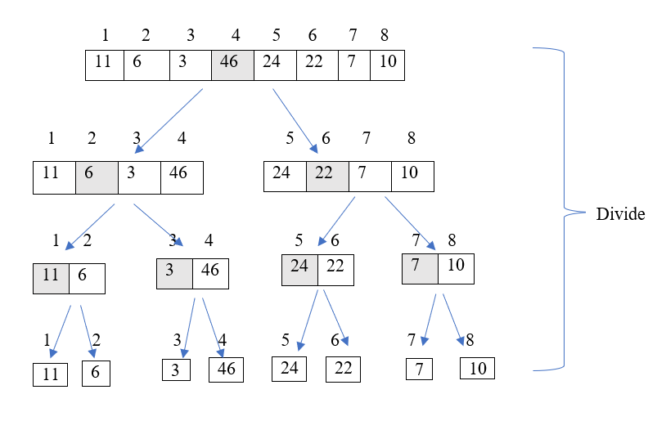
EXAMPLE

Slide 11
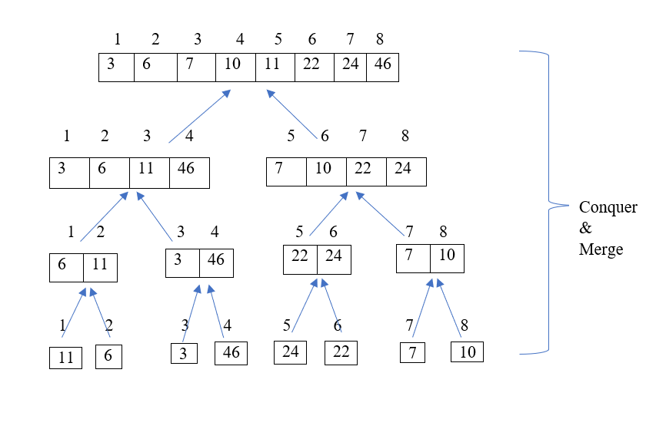
EXAMPLE

Slide 12
Way of Merging Two Sorted Arrays
a1 a1 a2
a1
5 | 6 | 8 | 9
4 | 7 | 10
j
i
Check whether a1[i]<a2[j] or a2[j]<a1[i]
If a1[i]<a2[j] then place the value in array and increment i & k
If a2[j]<a1[i] then place the value in array and increment j & k
k
Now..Now…Lets merge a1 & a2 as a single array ‘A’

Slide 13
Way of Merging Two Sorted Arrays Cont…
5 | 6 | 8 | 9
4 | 7 | 10
a1
a2
j
i
Here a2[j]<a1[i] so put the value of a2[j] to A[k], increment j and k
4
A
k
a1
a2
5 | 6 | 8 | 89
 | 7 | 10
i
j
4
A
k

Slide 14
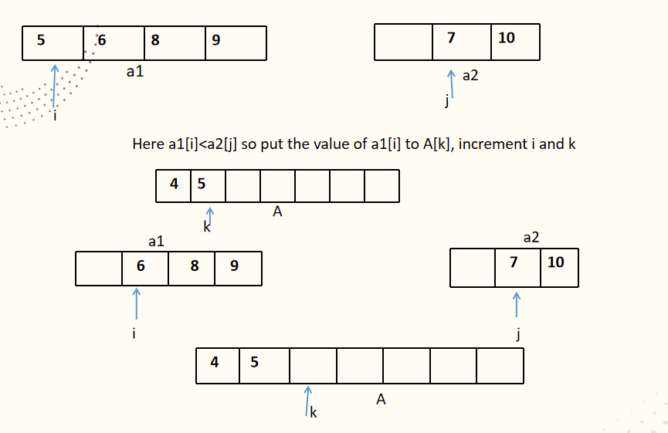
Example Cont….

Slide 15
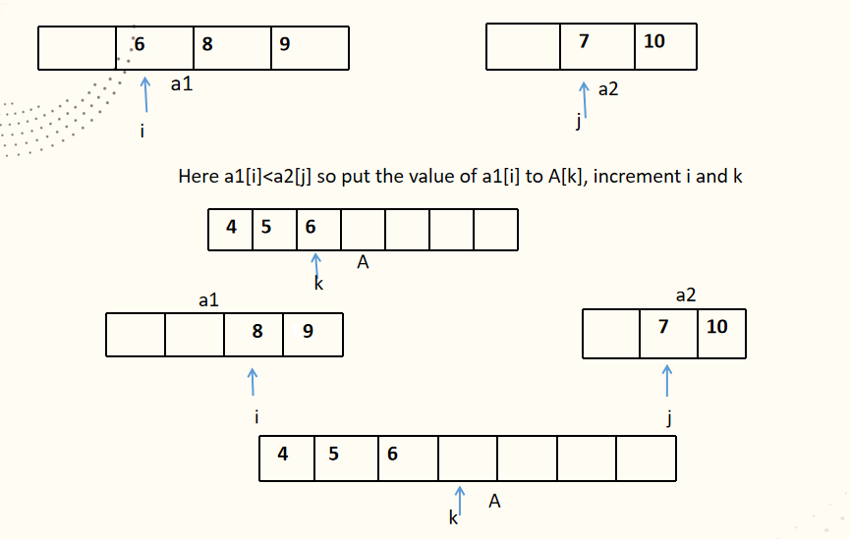
Example Cont….

Slide 16
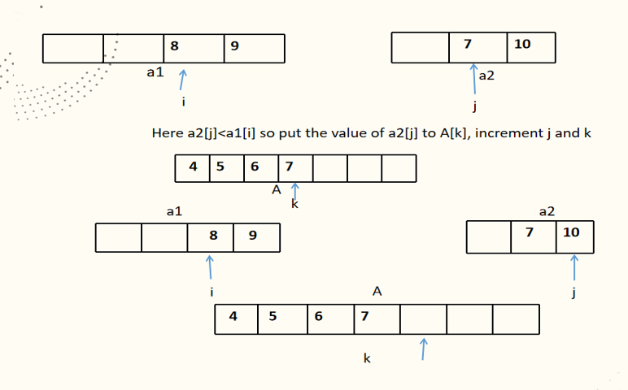
Example Cont….

Slide 17
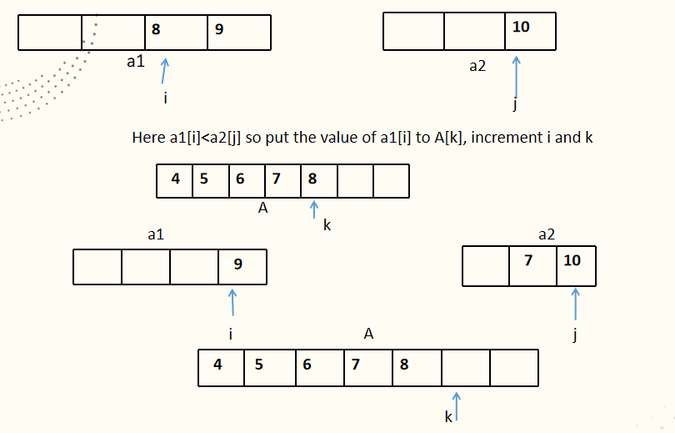
SUMMARY

Slide 18
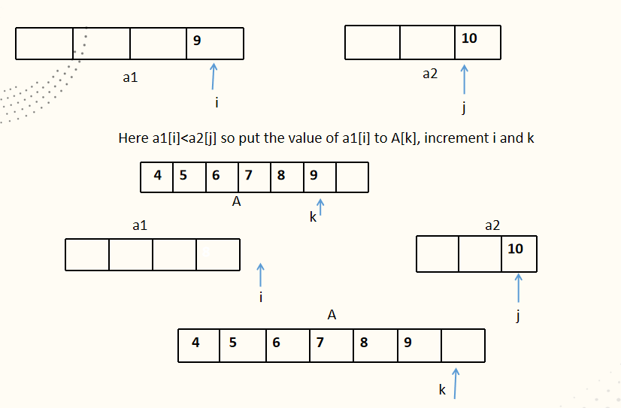
Example Cont….

Slide 19
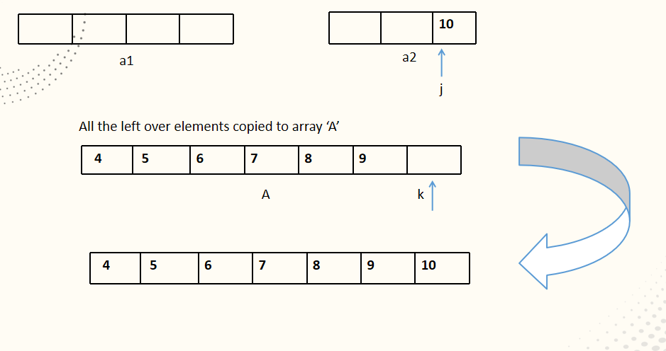
Example Cont….

Slide 20
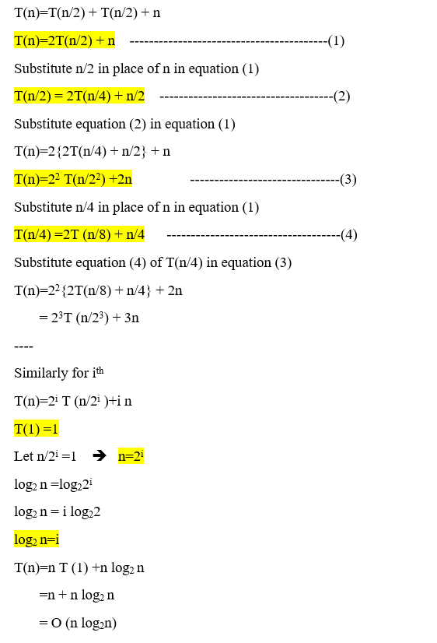
Time Complexity

Slide 21
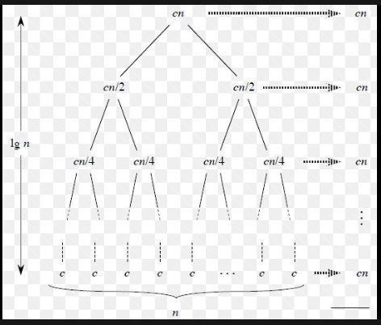
Time Complexity
Time Complexity of merge sort is O(n*Log n) in all the 3 cases (worst, average and best) as merge sort always divides the array in two halves and takes linear time to merge two halves.

Slide 22
SELF-ASSESSMENT QUESTIONS
What is the best case time complexity of merge sort?
O(n log n)
O(n²)
O(n² log n)
O(n log n²)
2.Merge sort is preferred for arrays over linked lists.
a) true
b) false

Slide 23
TERMINAL QUESTIONS
1. Describe Sorting and what are the key steps involved in implementing Merge Sort?
2. List out the applications of Merge Sort.
3. Analyze Time and Space Complexity of Merge Sort.
4. Summarize the Merge Sort algorithm with an example.

Slide 24
REFERENCES FOR FURTHER LEARNING OF THE SESSION
Reference Books:
1. A . V. Aho , J. E. Hopcroft, and J. D. Ullman, “Data Structures And Algorithms”, Pearson Education, First Edition Reprint2003.
2. Horowitz, Sahni , Anderson Freed, “Fundamentals of data structures in C” , Second Edition-2007.
3. R. F. Gilberg, B. A. Forouzan, “Data Structures”, Second Edition, Thomson India Ed ition, 2005
4. Robert Kruse, C.L. Tondo, Bruce Leung, Shashi Mogalla, “Data Structures & Program Design in C”, FourthEdition-2007.
Sites and Web links:
1. https://www.w3schools.in/data-structures/sorting-techniques/merge-sort-algorithm
2. https://www.geeksforgeeks.org/c-program-for-merge-sort/
3. https://www.javatpoint.com/merge-sort

Slide 25
THANK YOU

